Slide 1


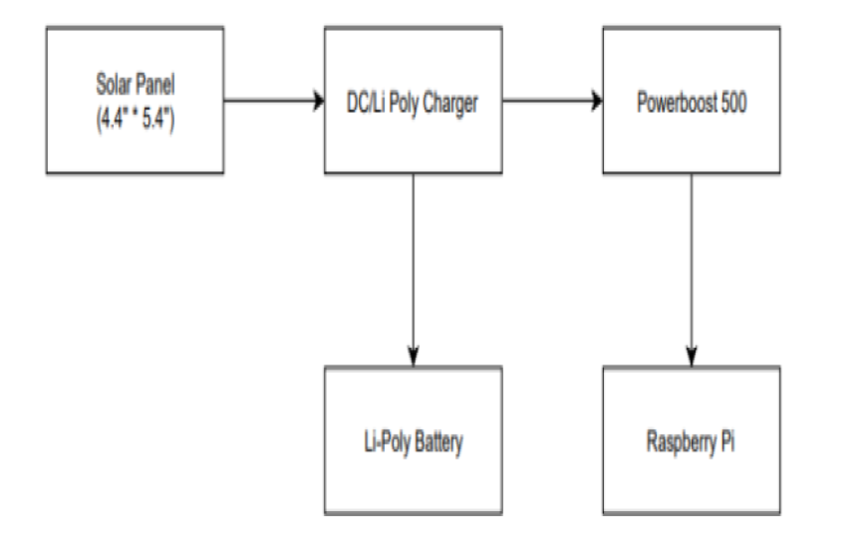
Hardware
Department of Electrical and Computer Engineering, Auburn University, Auburn, Alabama, USA
Raspberry Pi 3
Motion Processor Unit
Powering The Device
Like all engineering projects, our group needed a computer to handle our needs. The Raspberry Pi 3 is a
programmable micro-controller that is compatible with the MPU we've selected. The features covered by the Raspberry Pi are exactly what our team needs to begin
a prototype. Below one will find the features that attracted us the most :
- Cortex-A53 (ARMv8) 64-bit SoC
- Clock Speed: 1.4GHz
- 2.4GHz and 5GHz IEEE 802.11.b/g/n/ac wireless LAN, Bluetooth 4.2, BLE
- Gigabit Ethernet over USB 2.0 (maximum throughput 300 Mbps)
- Full-size HDMI
- 4 USB 2.0 ports
- Micro SD port for loading your operating system and storing data.
- An accelerometer will be needed to detect when a distress call should be signaled.
- Sparkfun IMU Breakout MPU-9250 that will be used throughout this project, which features a 3-axis accelerometer.
- When an object of specific weight falls into the water, it cause water ripples of certain magnitude to spread throughout the water.
- A change in acceleration of the waves then causes an applied force on the MPU.
- Another feature of the Sparkfun MPU is an integrated 3-axis gyroscope.
- The gyroscope can be helpful by identifying a specific change in angular velocity.
- By configuring the MPU onto the Raspberry-Pi microcontroller, an effective motion detection device can be achieved.
- The Li/Poly charger would connect to the 2W, 6V solar panel.
The Charger is connected to a Li/Poly battery. This battery has a capacity of 2500mAh for a total of about 10 Wh, and the output ranges from 4.2V when completely charged to 3.7V.
One of the outlets of the charger will be connected to
the Powerboost 500 component. This little DC/DC boost converter module can be powered by any 3.7V
LiIon/LiPoly battery, and convert the battery output to 5.2V DC, to run the Raspberry Pi.
Raspberry Pi 3
Sparkfun IMU Breakout MPU-9250 Board
Powerboost 500
DC/Li Poly Charger
Wiring For Powering The Device

